Slide 1
Object Oriented Programming
Inheritance
Polymorphism

Slide 2
Inheritance
Inheritance is a mechanism of acquiring the features and behaviors of a class by another class.
The class whose members are inherited is called the base class, and the class that inherits those members is called the derived class.
Inheritance implements the “IS-A “ relationship (Association).
Example:
Car is-a Vehicle, Teacher is-a Employee

Slide 3
Inheritance
Types of inheritance
Single Inheritance
Multiple Inheritance (Not directly supported in C#)

Slide 4
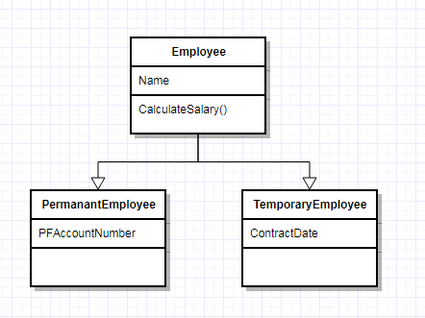
Inheritance
Single Inheritance

Slide 5
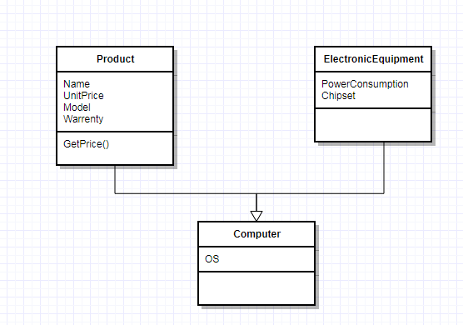
Inheritance
Multiple Inheritance

Slide 6
Inheritance Benefits
Reduce code redundancy.
Provides code reusability.
Reduces source code size and improves code readability.
Code is easy to manage and divided into parent and child classes.
Supports code extensibility by overriding the base class functionality within child classes.

Slide 7
Inheritance Disadvantages
Coupling : In Inheritance base class and child classes are tightly coupled. Hence If you change the code of parent class, it will get affects to the all the child classes.
Memory : In class hierarchy many data members remain unused and the memory allocated to them is not utilized. Hence affect performance of your program if you have not implemented inheritance correctly.

Slide 8
Polymorphism
Polymorphism means “Many forms”
Example : public int AddNumbers(int a, int b) {} public int AddNumbers(int a, int b, int c){}
Types of Polymorphism
Compile time polymorphism
(Called as Early Binding or Overloading or static binding)
Runtime polymorphism
(Called as Late Binding or Overriding or dynamic binding)

Slide 9
Inheritance and Polymorphism
Code demo

Slide 10
Polymorphism - Advantages
Modularity
Extensibility

Slide 11
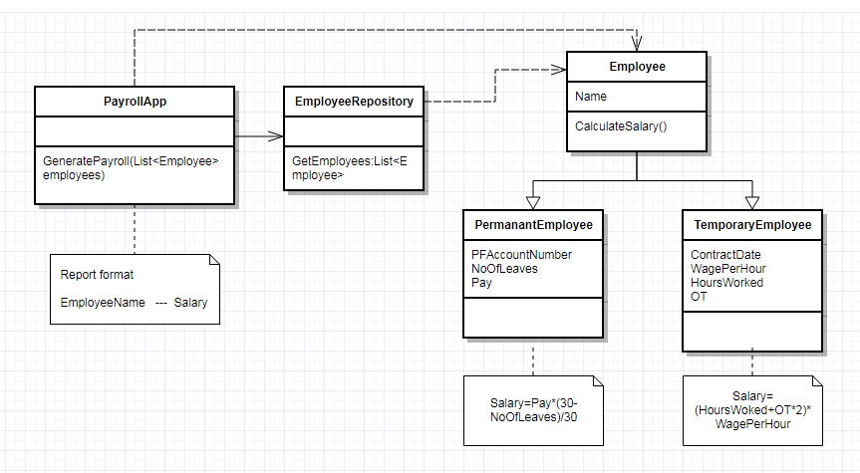
Inheritance and Polymorphism
Exercise

Slide 12
Object-Oriented Programming Basic Concepts
?
Questions?
?
?
?
?
?
?

Slide 13
THANKS

Slide 14
Reusability by Composition
Composition is a specialized form of aggregation in which if the parent object is destroyed, the child objects would cease to exist
Tips:
Prefer Composition when not sure about Inheritance
Prefer Composition when not all the super class functions where re-used by sub class
Inheritance leads to tight coupling between the classes
Composition makes the code maintainable

Slide 15
Composition / Inheritance?
One has to have proper reason to use composition/inheritance
Tips:
Prefer Composition when not sure about Inheritance
Prefer Composition when not all the super class functions where re-used by sub class
Inheritance leads to tight coupling between the classes
Composition makes the code maintainable

Slide 16
Heading
Point 1
Point 2

Slide 17
Heading
Point 1
Point 2

Slide 18

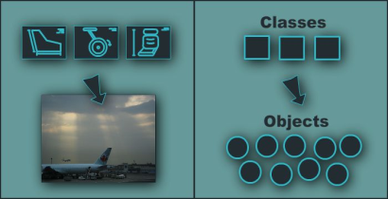
Introduction to Class and Object
Notes:
(c) 2006 National Academy for Software Development - http://academy.devbg.org*
18##

Slide 19
Classes and Objects
Classes define attributes and behavior
Fields, properties, methods, etc.
Methods contain code for execution
Object is an instance of a class
Objects has state(data) and behavior(function)
public class Student { … }
Student std = new Student();

Slide 20
Objects
An object is a concrete instance of a particular class
Creating an object from a class is called instantiation
Objects have state
Set of values associated to their attributes

Slide 21
Classes
Basic units that compose programs
Implementation is encapsulated (hidden)
Classes in C# can contain:
Fields (member variables)
Properties
Methods
Constructors
Inner types
Etc. (events, indexers, operators, …)

Slide 22
Fields and Properties

Slide 23
Fields
Fields are data members of a class
Can be variables and constants
Accessing a field doesn’t invoke any actions of the object
Constant fields can be only read
Variable fields can be read and modified

Slide 24
Properties
Properties look like fields (have name and type), but they can contain code, executed when they are accessed
Usually used to control access to data fields (wrappers), but can contain more complex logic
Can have two components (and at least one of them) called accessors
get for reading their value
set for changing their value

Slide 25
Properties (2)
According to the implemented accessors properties can be:
Read-only (get accessor only)
Read and write (both get and set accessors)
Write-only (set accessor only)

Slide 26
Instance and Static Members
Fields, properties and methods can be:
Instance (or object members)
Static (or class members)
Instance members are specific for each object
Example: different persons have different name
Static members are common for all instances of a class
Example: DateTime.MinValue is shared between all instances of DateTime

Slide 27
Accessing Members – Syntax
Accessing instance members
The name of the instance, followed by the name of the member (field or property), separated by dot (".")
Accessing static members
The name of the class, followed by the name of the member
<instance_name>.<member_name>
<class_name>.<member_name>

Slide 28
Methods
Methods manipulate the data of the object to which they belong or perform other tasks
Examples:
Console.WriteLine(…)
Console.ReadLine()
String.Substring(index, length)
Array.GetLength(index)

Slide 29
Instance Methods
Instance methods manipulate the data of a specified object or perform any other tasks
If a value is returned, it depends on the particular class instance
Syntax:
The name of the instance, followed by the name of the method, separated by dot
<object_name>.<method_name>(<parameters>)

Slide 30
Static Methods
Static methods are common for all instances of a class (shared between all instances)
Returned value depends only on the passed parameters
No particular class instance is available
Syntax:
The name of the class, followed by the name of the method, separated by dot
<class_name>.<method_name>(<parameters>)

Slide 31
Constructor & Destructor

Slide 32
Constructor
Constructors are special methods used to assign initial values of the fields in an object
Executed when an object of a given type is being created
Have the same name as the class that holds them
Do not return a value
A class may have several constructors with different set of parameters
Constructor is invoked by the new operator

Slide 33
Types of Constructors
Default Constructor
Parameterized Constructor
Copy Constructor
Static Constructor
Private Constructor

Slide 34
Destructor
Destructors are used to destruct instances of classes.
A class can only have one destructor.
Destructors cannot be called. They are invoked automatically.
A destructor does not take modifiers or have parameters.

Slide 35
Destructor (2)
Example:
class Car {
~Car() // destructor
{
// cleanup statements...
}
}

Slide 36
Accessibility Levels
Access modifiers in C#
public – access is not restricted
private – access is restricted to the containing type
protected – access is limited to the containing type and types derived from it
internal – access is limited to the current assembly
protected internal – access is limited to the current assembly or types derived from the containing class

Slide 37
Namespaces
Namespaces are used to organize the source code into more logical and manageable way
Namespaces can contain
Definitions of classes, structures, interfaces and other types and other namespaces
Namespaces can contain other namespaces

Slide 38
Full Class Names
A full name of a class is the name of the class preceded by the name of its namespace
Example:
Array class, defined in the System namespace
The full name of the class is System.Array
<namespace_name>.<class_name>

Slide 39
Including Namespaces
The using directive in C#:
Allows using types in a namespace, without specifying their full name
Example:
instead of
using <namespace_name>
using System;
DateTime date;
System.DateTime date;

Slide 40
Message and Methods
Messages are instruction to a class or an object to perform a task.
The class or object should posses a matching Method to handle the messages
Value pass to an object when sending a message is called argument.
Objects talk to each other via Messages.

Slide 41
Encapsulation
Encapsulation is the integration of data and the operations into a class.
Encapsulation hides the functional details from the object calling it.

Slide 42
Abstraction
Abstraction refers to showing only the necessary details to the intended user. As the name suggests, abstraction is the "abstract form of anything".
Abstraction in programming languages is used to make abstract class. Abstract class represents abstract view of methods and properties of class.

Slide 43
Abstract Class
The abstract keyword enables you to create classes and class members that are incomplete and must be implemented in a derived class.
An abstract class cannot be instantiated. The purpose of an abstract class is to provide a common definition of a base class that multiple derived classes can share.
An Abstract class can have abstract methods

Slide 44
Sealed Class
The sealed keyword (C#, final in java) enables you to prevent the inheritance of a class or certain class members that were previously marked virtual.
Sealed class cannot also be an abstract class.
Sealed class members slightly faster.

Slide 45
Interfaces
An interface is a contract consisting of a related function prototypes whose usage is defined but whose implementation is not
An interface looks like a class, but has no implementation. The only thing
It contains only declarations of events, methods, properties or indexers .
A class or struct that implements the interface must implement the members of the interface that are specified in the interface definition.

Slide 46
Interfaces (2)
Defining an Interface
interface IMyInterface{ void myMethod (); }
Using an interface
class myClass : IMyInterface { public void myMethod () { } }

Slide 47
Coupling
Coupling defines how depend one object on another object
Coupling is a measure of strength of connection between any two system components.
The more any components knows about other components – coupling is tighter (worse design)

Slide 48
Cohesion
Cohesion is the extent to which two or more parts of a system are related and how they work together to create something more valuable than the individual parts.
Low coupling and tight cohesion is good Object Oriented Design (OOD)

Slide 49
Principles of class design
Single Responsibility Principle (SRP)
Open Close Principle (OCP)
Liskov Substitution Principle (LSP)
Dependency inversion Principle (DIP)
Interface segregation Principle (ISP)

Slide 50
Single responsibility principle
Each responsibility should be a separate class, because each responsibility is an axis of change.
A class can have one and only one reason to change.

Slide 51
Open Close Principle
Software entities (classes, modules, functions, etc.) should be open for extensions but closed for modification
In other words (in an ideal world) you should never change an existing code or class: All new functionality can be added by using subclasses or methods or by reusing the existing code

Slide 52
Liskov Substitution Principle
Derived types must be completely substitutable for their base types
This principle is just an extension of the Open Close Principle and it means that we must make sure that new derived classes are extending the base classes without changing their behavior.

Slide 53
Dependency Inversion
High level modules should not depend to low level modules, both should be depend upon abstractions.
Abstractions should not depend on details. Details should depends upon abstractions
A bad design means;
Rigid (Hard to change due to dependencies on )
Fragile (Changes cause unexpected bugs)
Immobile (difficult to reuse due to implicit dependence on current application code)

Slide 54
Interface Segregation
Clients should not forced to methods that they do not use.
ISP says that once an interface become too fat it need to split in to smaller and more specific interfaces

Slide 55
Object-Oriented Programming Basic Concepts
?
Questions?
?
?
?
?
?
?

Slide 56
THANKS

